Slide 1
Credit EDA Case Study
DS Group

Slide 2
Problem Statement
The loan providing companies find it hard to give loans to the people due to their insufficient or non-existent credit history. Because of that, some consumers use it as their advantage by becoming a defaulter. Suppose you work for a consumer finance company which specialises in lending various types of loans to urban customers. You have to use EDA to analyse the patterns present in the data. This will ensure that the applicants capable of repaying the loan are not rejected.
Major Problems:
If the applicant is likely to repay the loan, then not approving the loan results in a loss of business to the company
If the applicant is not likely to repay the loan, i.e. he/she is likely to default, then approving the loan may lead to a financial loss for the company.

Slide 3
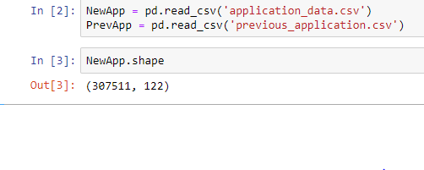

Data Cleaning
Shape:
Null Values Treatment:
Drop more than 50% of null values in respective columns as they don’t show impact on our analysis.
Columns which have less than 13% of null values can be imputed based on the type of column choosing MEAN, MEDIAN, MODE.
There are 41 columns which are having more than 50% of NULL values which are dropped.

Slide 4
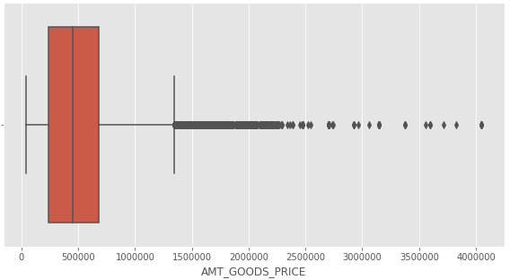
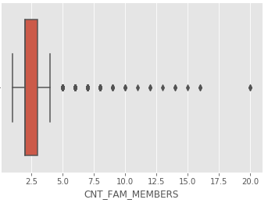
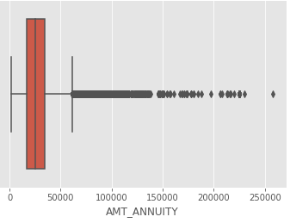
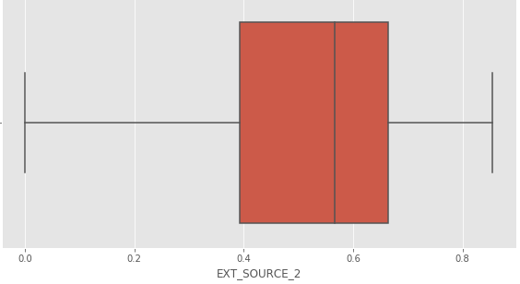
imputations of Columns
AMT_GOODS_PRICE, CNT_FAM_MEMBERS, AMT_ANNUITY are continuous variable with outliers we can impute column using median value
EXT_SOURCE_2 has no outlier, we can choose mean to impute the column.
NAME_TYPE_SUITE, OCCUPATION_TYPE are categorial Column, so can be imputed using the mode

Slide 5
Checking Data type of Column
The columns starting with 'DAYS‘ which consist of negative days converted to negative values.
CODE_GENDER has only 4 counts in XNA category so we dropped the values from the dataset. That won’t impact our analysis.
ORGANIZATION_TYPE: replaced the value 'XNA' which means not available with np.NaN

Slide 6
Identifying Outliers
AMT_CREDIT has outliers above max range in box plot. So binning these into categorical will be better option.
CNT_CHILDREN has outliers, to handle these outliers, median is best imputation or could be removed these entries as they won't effect EDA analysis.
AMT_INCOME_TOTAL We observe a value of 1.2 which is an outlier. so we can drop this row.
AMT_ANNUITY We observe a value which is greater that 258000 which is an outlier. so we can drop this row.
Client_Age: Age varies from 20 to 69, we created bins of 5 years starting from 20 to 70

Slide 7
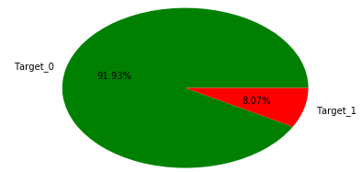
Checking for imbalance in Target
There is an imbalance between people who defaulted and who didn't default. More than 92% of people didn't default as opposed to 8% who defaulted.
There are no much significant inference we could able to draw, This is because of data imbalance percentage. As there is no balancing technique required we could draw inference with existing data.

Slide 8
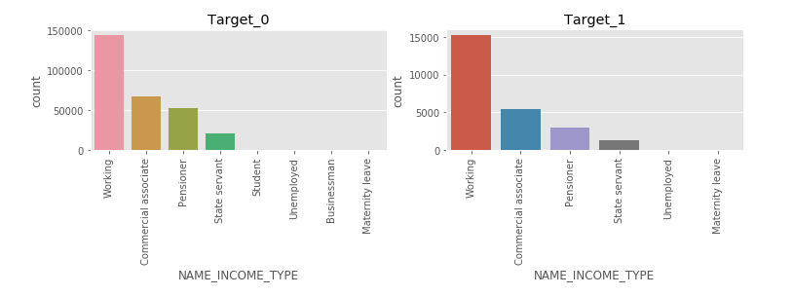
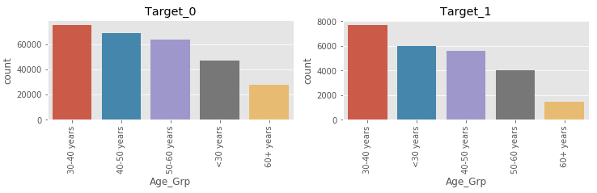
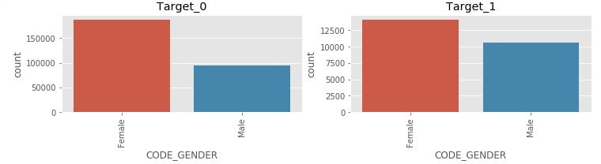
UNIVARIATE ANALYSIS
If we consider about age group in target 0 the chances of getting non-defaulter for age_grp 30-40 is reletively high where as for the target 1 the chances of getting defaulted is also high
For the NAME_INCOME_TYPE category student and businessman are playing minor role target 0 but in target 1 there is no such case.
Also for Code Gender category around 125000 we could see the female category is getting high in payment difficulties

Slide 9
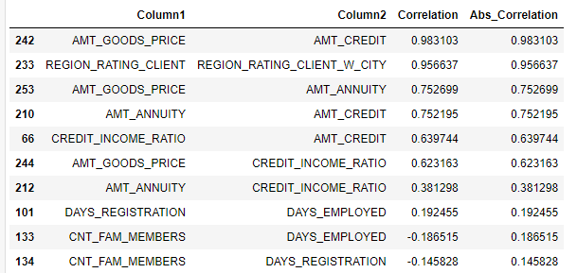
Correlation
Highest correlation exist between AMT_CREDIT and AMT_GOODS_PRICE there is something related to this column.
There is negative correlation existing between CNT_CHILDREN and DAYS_BIRTH
Least correlation exist between the DAYS_EMPLOYED and DAYS_ID_PUBLISH

Slide 10
Bivariate Analysis
On Categorical columns of 'Target 0' and 'Target 1:
The female gender who does't own a car are more non-defaulters and its the same the same for likelt to default.
The male gender who owns a House / apartment are more likely to default than non-defaulters.
The occupation type core staff who owns of House/apartment are more in number of non-Defaulters whereas the occupation type Laborers who owns of House/apartment are high in number to likely to default.
The Male Gender laborers doesn't have significant difference between Non-Defaluting and likely to default and the female sales staff members are more in number of Non-Defaulters than likely to default.
Continous and categorical variables and Continous to continous:
Applicants who have high income and with no childeren are more likely to default.
Providing a loan amount of Range 500000-2500000 to the total income of Less 500000 are more likely to default than non-default.
There are more people who haven't paid back their loans on time with a total income of less than 500000 and are more likely ot default.
The variables AMT_ANNUITY abd AMT_CREDIT for both non-defaulters and Defaulters has a strong correlation and also has similar pattern between them.

Slide 11
Insights on Univariate Analysis and Bivariate analysis of Combined data frame of Categorical Varibales
There are around 70000-80000 whose loans are approved who are likely to default and also over 200000 applicant's loan is refused who are less likely to defualt this would incurr loss to the bank.
There is few applicant's loan with secondary / secondary special who face difficulties to pay loan on time than who are likely to pay on time.
Female Gender are more likely to not face payment difficulties then the male and hence it is recommended to approve more loans of Female Gender than the male gender at the same Female are High in number than who face difficulties than males.
Laborers are high in number of occupation type list who are likely to default or payment difficulties.
The Repeater applicant has High chance of non-Defaulting and also has high chance of defaulting when compared to new applicants.
No millionaire is likely to default so should not refused a application of millionaire's application for loan and Lower Middle class people are high in number to repay the loans

Slide 12
THANK YOU
Satabdi Gantayat

